Slide 1
EinStein Würfelt Nicht!
Variant Puzzle Simulator
Dong Hanyu
Qiu Ziming
Tian Xu
Wu Yihang

Slide 2
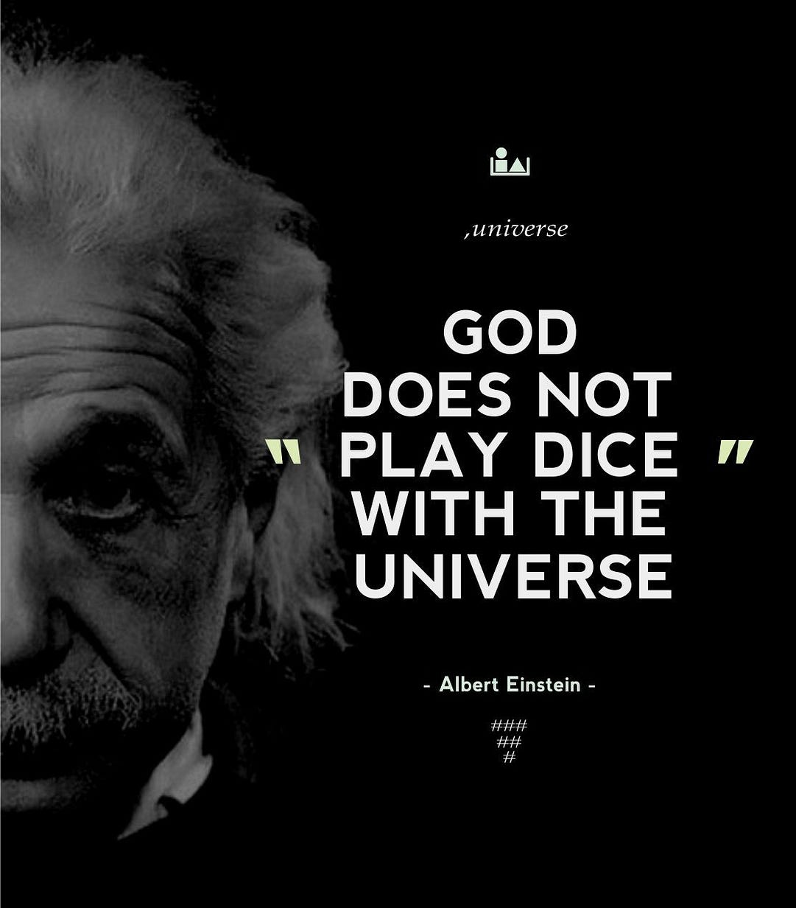
"God does not play dice"
— Albert Einstein
Einstein believed in a deterministic universe.
Our project tackles the "EinStein würfelt nicht!" puzzle variant, focuses on a 10x10 deterministic puzzle where our goal is to simulate and solve levels using specific movement rules.

Slide 3


Slide 4



Team Responsibilities
Dong Hanyu
Tian Xu
Qiu Ziming
Wu Yihang
Game State & Loader
Player Hierarchy
Game Main & Interaction
AI Player & Algorithms

Slide 5


Core Logic Implementation by Dong Hanyu
GameLoader.java
GameState.java
Responsible for parsing level files (e.g., level1.txt). It extracts:
The "Rule Engine" of the simulator.
Grid Logic: Manages the 10x10 board (0-99).
•
Target Piece
Move Generation: Generate valid moves based on dice rolls.
•
Initial Piece Positions (6 pieces)
•
Dice Sequence
Outputs initial setup to moves.txt.
Win Condition: Checks if the target piece reaches square 0.

Slide 6
Player Architecture by Tian Xu
Abstract Player Class
RandomPlayer
Designed a flexible base class to ensure polymorphism.
A random agent used for baseline testing.
•
Defines the contract: chooseMove(GameState state).
•
Selects a valid move from generatePossibleMoves() at random.
•
Handles output formatting via printMove().
Useful for checking game stability but fails on complex levels.
•

Slide 7
Interaction & Execution
HumanPlayer.java
GameMain.java
•
Enables manual testing and debugging.
•
The core game loop.
•
Implements a Command Line Interface (CLI) that prompts the user to select valid moves based on the current dice roll, validating input against the GameState rules.
•
Orchestrates the simulation flow: Loading Levels → Initializing Player → Loop (Move → Update State → Check Win) → Final Output.

Slide 8
The AI Challenge
Implementing an autonomous solver using Search Algorithms.

Slide 9
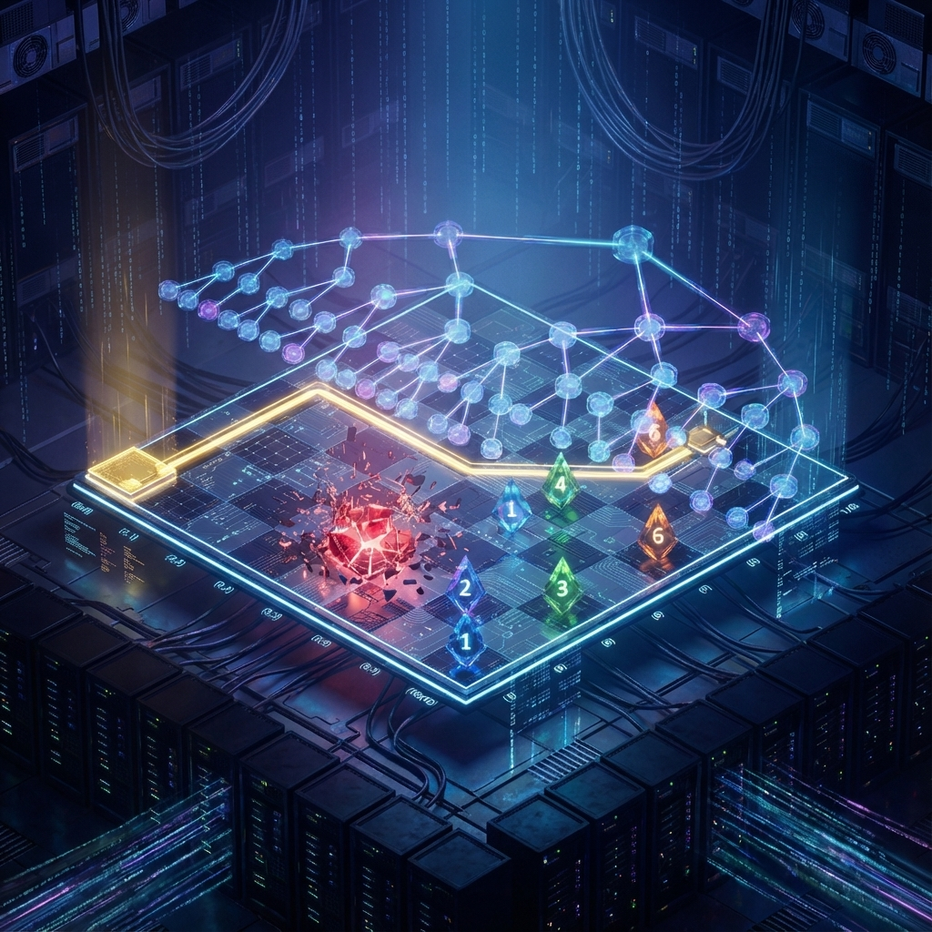
A* Search
The AIPlayer uses the A* algorithm to find the optimal path to victory.
The "Node" Class: We defined a custom inner class Node that stores:
•
Current round (Cost g(n))
•
piecePositions
•
totalDistance (Priority score f(n))
•
Reference to previousNode (for path reconstruction)
A PriorityQueue manages these nodes, always exploring the most promising state first.

Slide 10
The Heuristic Function
To solve the puzzle efficiently within 15 seconds, we utilize a custom cost function:
Cost g(n): The current round number. We want the fastest win.
Heuristic h(n): A composite score based on: 1. Distance of Target Piece to goal (Weighted 7 - pieceCount). 2. The sum of pairwise distances between all pieces.
3.
* Here, distance is defined as the chessboard distance, representing the minimum moves a piece needs to travel between two points.
This heuristic prioritizes moves that minimize the distance to the goal and optimize piece positioning.

Slide 11
Performance Evaluation
The AI Player successfully solves all challenge levels well under the 15-second limit.
Level 1: The solution is found after searching 8 positions.
Level 2: The solution is found after searching 15 positions.
Level 3: The solution is found after searching 11 positions.
Level 4: The solution is found after searching 17 positions.

Slide 12
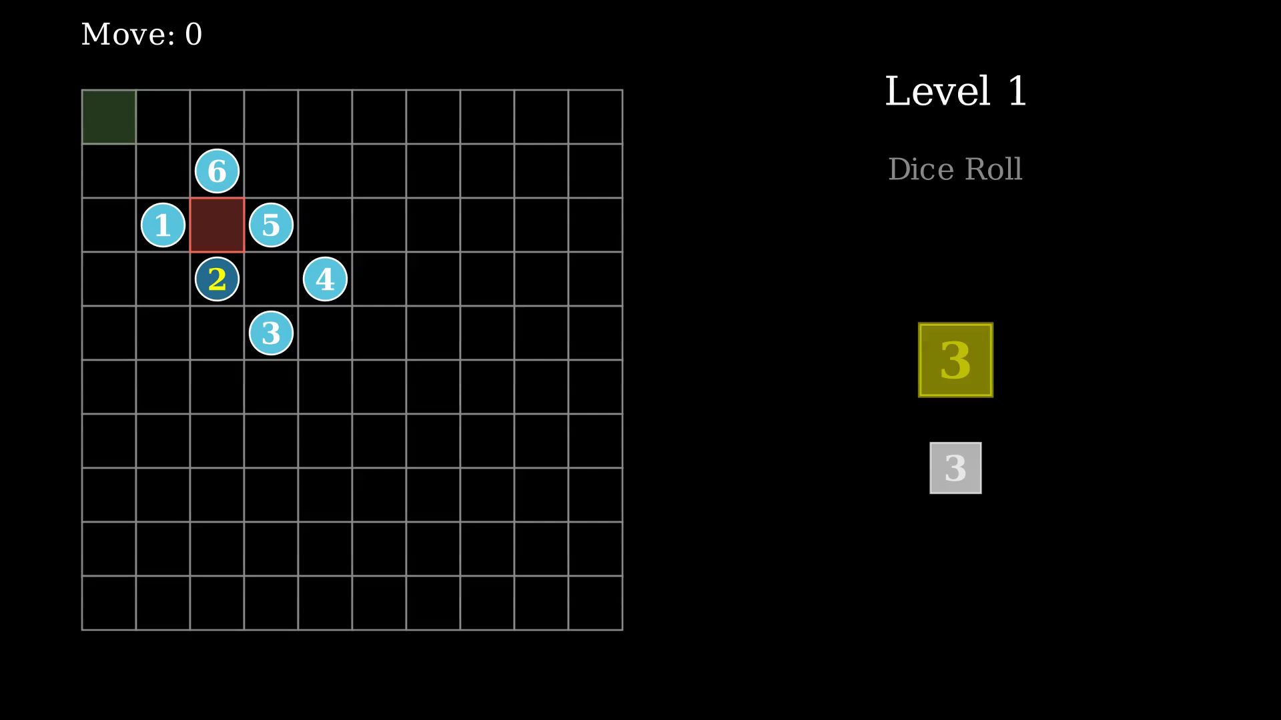

Slide 13
Thank You

